Slide 1

SwissADME

Slide 2
Content
Introduction
Objectives
Input & Output
Parameters
Results Analysis
Conclusion

Slide 3

Introduction
SwissADME is a free web tool to evaluate pharmacokinetics, drug-likeness and medicinal chemistry friendliness of small molecules.

Slide 4
“
SwissADME is used to compute physicochemical descriptors as well as to predict ADME parameters, pharmacokinetic properties, druglike nature and medicinal chemistry.”

Slide 5
Objectives
Analyzes
The server used to predict ADME parameters, pharmacokinetic properties, druglike nature and medicinal chemistry friendliness of one or multiple small molecules to support drug discovery.
Outcome
Available on
SwissADME is web based server and can be accessed through any web browser using windows, Linux or MacOS.
The SwissADME web tool presented here is freely accessible and meant for user-friendly submission and easy analysis of the results.

Slide 6

Input & Output
Input
Output
One or multiple molecules must be entered in the SMILES list field to be submitted to SwissADME calculations.
Server will compute the drug-like properties of the ligand compound and shows which ligand is better drug-like response against your query protein.

Slide 7
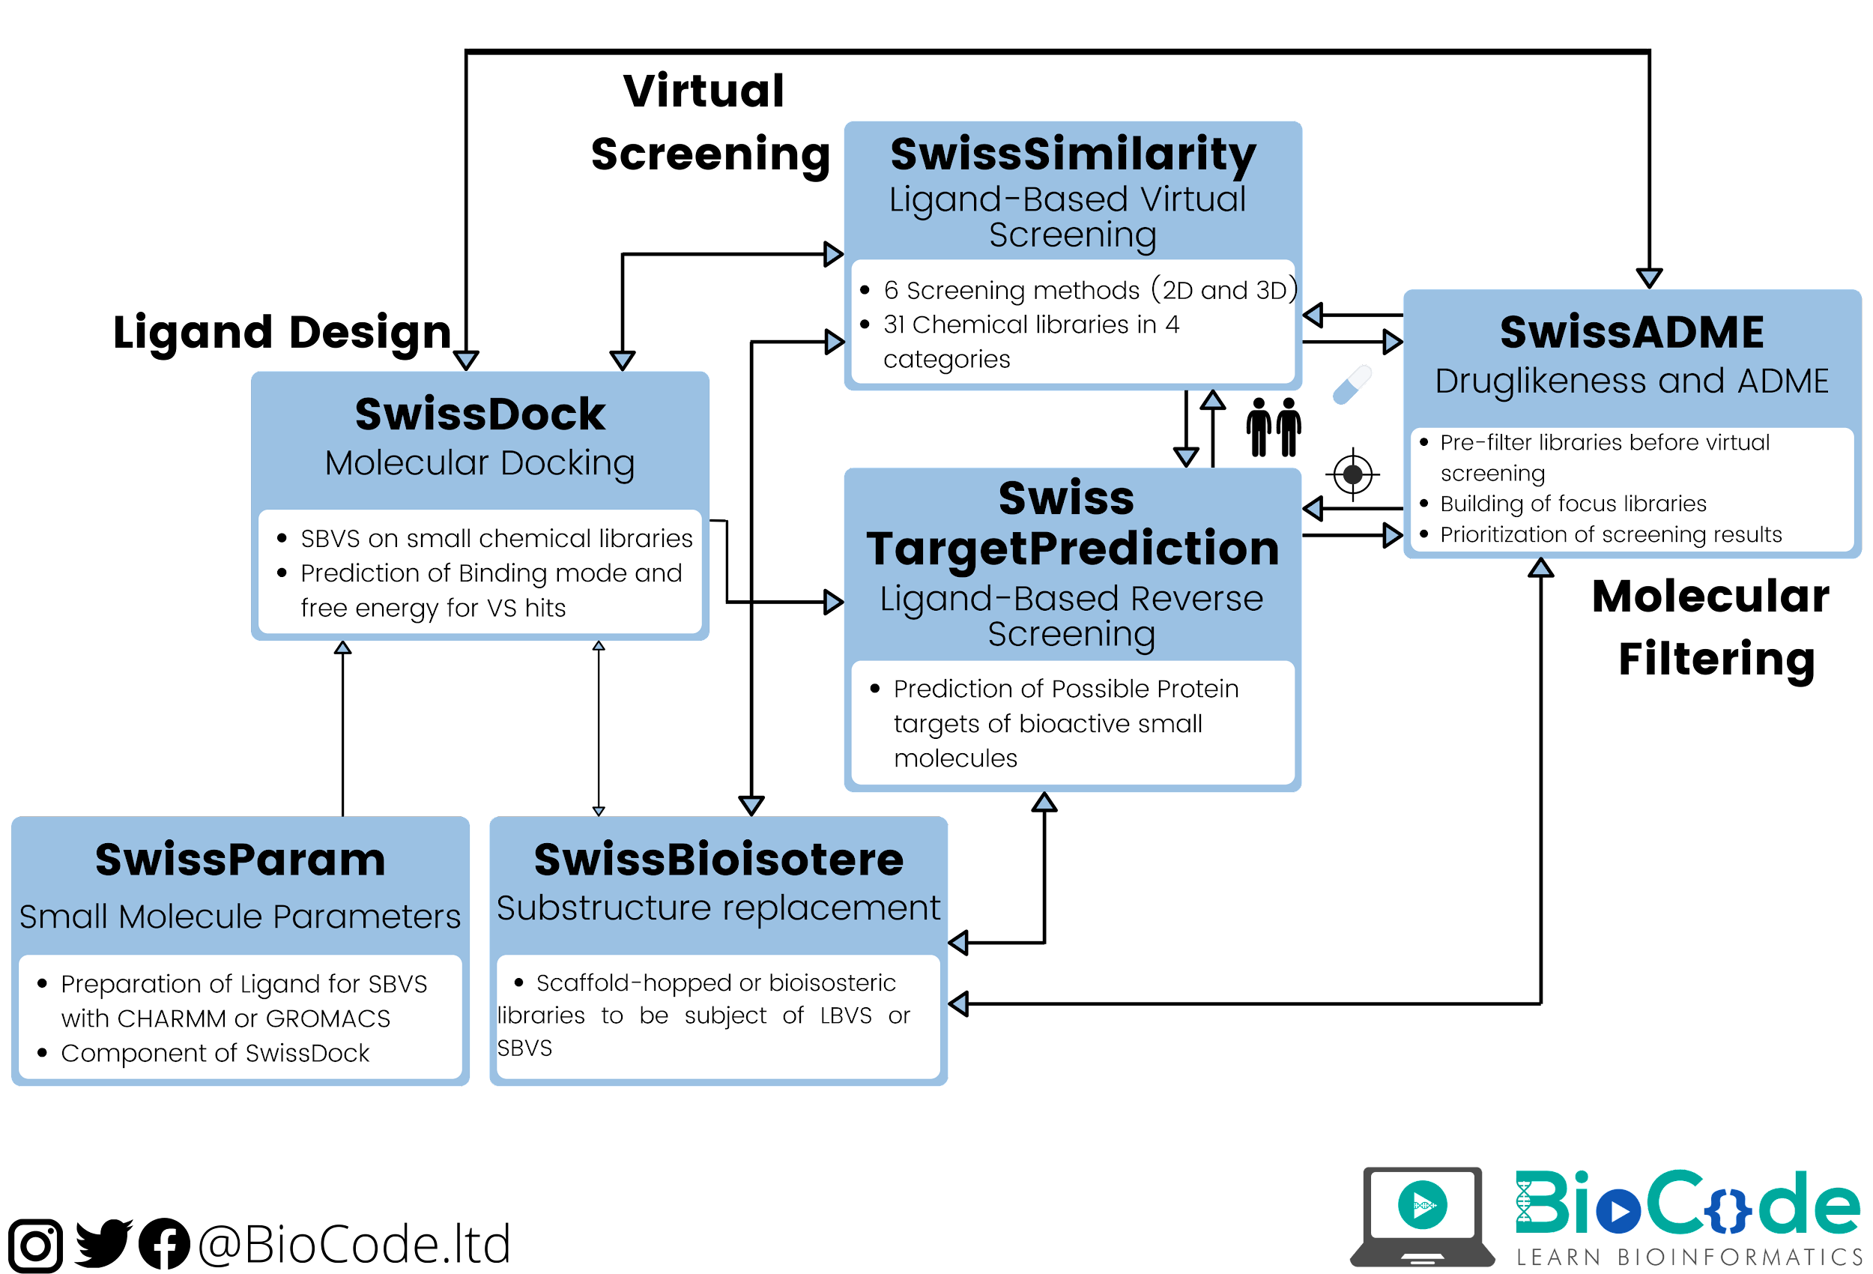
Applications of the different online tools for SwissDrugDesign project.

Slide 8
Graphical output
Molecular sketcher
BOILED-Egg" link appearing at the termination provides graphical output.
A molecular sketcher allows edit a 2D chemical structure to be transfered.
Parameters
Smiles list
One panel per molecule
All computed data for one molecule are compiled in a single panel.
SMILES list is a fully editable text field and is the actual input for a SwissADME run.
Output
Transfer
Output Panels compiling all the values for each molecule filled after calculation completion.
Transfer molecular structures to SMILES list.

Slide 9
Results Analysis
1st | Drug likeness | Nearer points in graph to the center indicate the better drug-likeness of the ligand compound.
2nd | LogP value | Lower the consensus LogP value, better the results are.
3rd | Pharmacokinetics | Provides the information of gastro-intestinal absorption, skin permeation and other inhibitory effects of the ligand compound.
4th | Medicinal chemistry | Provides the synthetic accessibility score of the ligand compound.

Slide 10

Conclusion
SwissADME gives free access to a number of parameters and predictive models in order to compute the physicochemistry and estimate the pharmacokinetics, druglikeness and medicinal chemistry friendliness of one or several small molecules.

