Slide 1
SignalP

Slide 2

Content
Introduction to SignalP
Uses and benefits of SignalP
SignalP Analyzes
Input & OutPut
Results Analysis
Parameters
Conclusion

Slide 3

Introduction
The SignalP server predicts the presence of signal peptides and the location of their cleavage sites in proteins from Archaea, Gram-positive Bacteria, Gram-negative Bacteria and Eukarya.

Slide 4
“
SignalP is the most widely used server in research for the identification of signal peptides and their cleavage sites based on neural networks trained on separate sets of prokaryotic and eukaryotic sequence.

Slide 5
Analyzes
Sec/SPII
Lipoprotein signal peptides transported by the Sec translocon and cleaved by Signal Peptidase II (Lsp)
Sec/SPI
Tat/SPI
"Standard" secretory signal peptides transported by the Sec translocon and cleaved by Signal Peptidase I (Lep)
Tat signal peptides transported by the Tat translocon and cleaved by Signal Peptidase I (Lep)

Slide 6

Input & Output
Input
Output
Server requires a single sequence (just the amino acids) or a number of sequences in FASTA format as the input.
Server produces output for input sequences and predicts signal peptide, cleavage site position and reports three marginal probabilities.

Slide 7
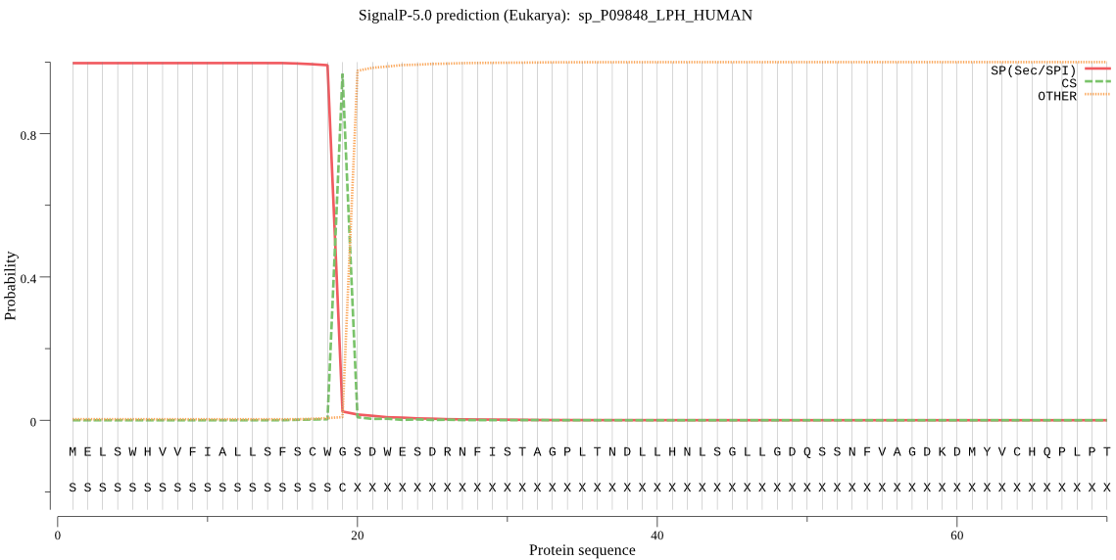
sp_P09848_LPH_HUMAN used as the query sequence and the following graph shows how SignalP predicts the signal peptide sequence.

Slide 8
Parameters
1st | Organism Group | Choose correct organism group as Archaea, Eukaryotes, Gram-negative bacteria or Gram-positive bacteria - since the signal peptides of these three groups are known to differ from each other.
2nd | Output Format | Standard-Shows one plot and one summary per sequence. Short-Shows only one line of output per sequence and no graphics.

Slide 9

Conclusion
SignalP is the currently most widely used tool for prediction of signal peptide from protein sequences. Among other Bioinformatics tools, SignalP is an efficient tool to improve the prediction of the presence of signal peptides and the location of their cleavage sites in proteins.

