Slide 1
MicroArray
Analysis
Here add the course title

Slide 2
INTRODUCTION
01.
Mercury is the smallest planet in the Solar System
02.
Saturn is composed mostly of hydrogen and helium

Slide 3
STUDY OBJECTIVES
MARS
VENUS
SATURN
NEPTUNE
Despite being red, Mars is a cold place
Venus is the second planet from the Sun
It’s composed of hydrogen and helium
Neptune is the farthest planet from the Sun

Slide 4
“This is a quote. Words full of wisdom that someone important said and can make the reader get inspired.”
—SOMEONE FAMOUS

Slide 5
Saturn
Mars
It has several rings
It’s a cold place
Research Outcome
Jupiter
Neptune
It’s the biggest one
It’s the farthest one
Venus
Pluto
It’s quite hot
It’s a dwarf planet

Slide 6
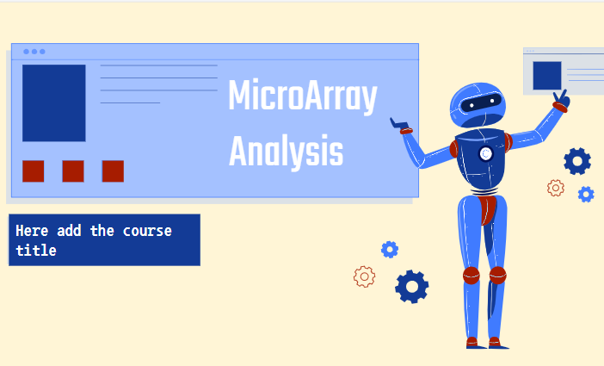
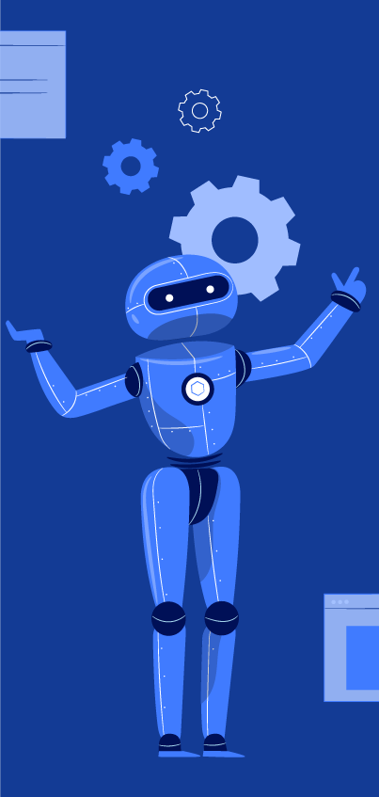
Conclusion
You can replace the image on the screens with your own work. Just delete these ones and add yours

Slide 7
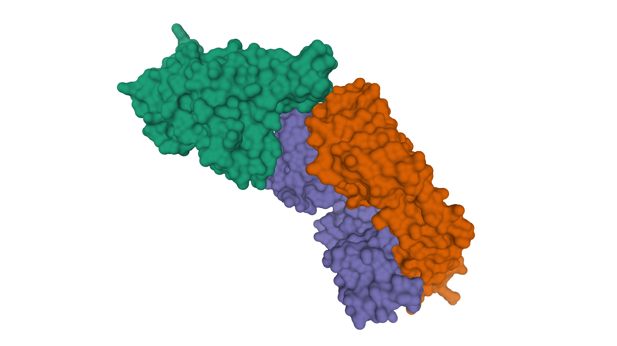
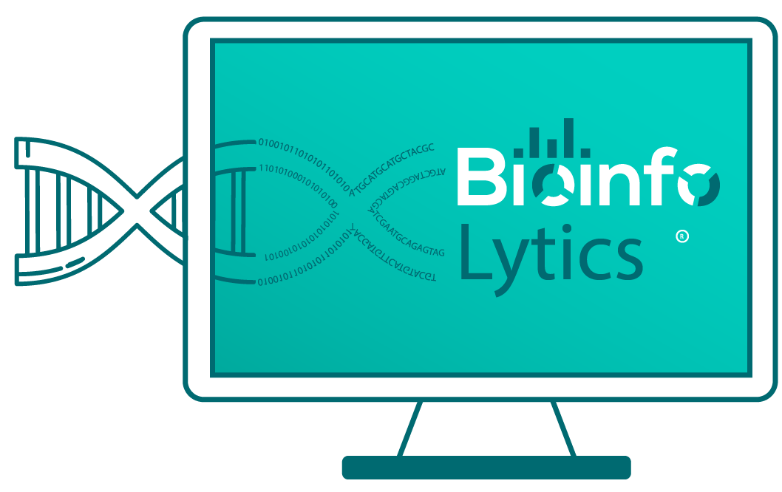
Learn Bioinformatics
Through Interactive Video Courses
Ever stuck upon a bioinformatics, computational biology, biological programming problem?
Do you want to learn Bioinformatics, Computational Biology, Biological Databases, Biological Programming?
Interactive Video Courses Available
Gray
Bioinformatics
Gold
Bioinformatics
Gem
Bioinformatics
Bioinformatics Premium Services
Enroll Now
Purchase Services
Bioinformatics & Computational Biology Courses
Biological Programming in Python & R Courses
Advanced Bioinformatics and Biological Programming Courses
9.99 USD/Month
16.99 USD/Month
18.99 USD/Month

