Slide 1
Introduction to Phytozome
Comparative Hub Plant Genomes

Slide 2
Content
Basic introduction to the Phytozome database.
Objectives of Phytozome.
Input & Output.
Integrated databases of phytozome.
Tools provided by the Phytozome.

Slide 3
“
Phytozome is a comparative hub for plant genome and gene family data and analysis”.

Slide 4


Phytozome
It provides a central hub which enables the users to access annotated plant genomes, navigation through their evolutionary history, and other genomic and functional information.

Slide 5
Objectives
Comparative Genomics
Evolutionary analysis
Functional genomics
It provides various tools for the comparative genome analysis of various plant genomes.
It provides the information for functional analysis of different plant genomes.
Various tools are hosted by Phytozome to analyze the evolutionary history between different plant genomes.

Slide 6
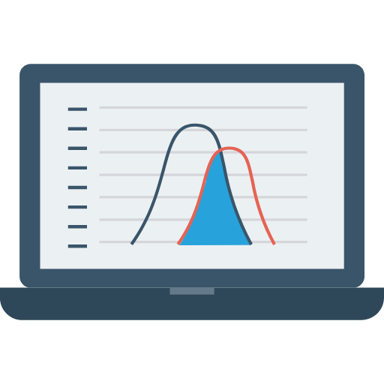
Input & Output
Input
Output
Query is searched against the database using keywords, accession IDs or organism/species name.
It provides various sorts of information about the query and access to different hyperlinks and tools for further analysis on the data.

Slide 7
Lucene
GBrowser
Integrated components
Pygr
Jalview
mView
BioMart

Slide 8
Tools
1st | Keyword search | Searching for any particular species using keywords.
2nd | BLAST | Perform BLAST search from within the Phytozome
3rd | JBrowse | It provides graphical visualization of genomes.
4th | PhytoMine | Allows the retrieval of query based data and mine the data from the entire database

Slide 9

Conclusion
Phytozome provides a view of the evolutionary history of every plant gene at the level of gene structure, gene family and genome organization. It also provides the access to the sequence and functional annotations of complete plant genomes at the same time.

