Slide 1
MicroArray
Analysis
Introduction to ArrayExpress - Getting Started With MicroArray Analysis

Slide 2
INTRODUCTION
01.
Microarray techniques used to interpret the data generated from experiments on DNA, RNA, and protein microarrays.
02.
Gene expression microarrays provide a snapshot of all the transcriptional activity in a biological sample.

Slide 3
Features
Microarray
Applications
Techniques
Methods
Allow researchers to investigate the expression state of a large number of genes.
Applications include discovering novel disease subtypes and identifying underlying mechanisms of disease or drug response.
Most microarray technologies, such as Affymetrix and Agilent, provide commercial data analysis software alongside their microarray products.
Open source options that utilize a variety of methods for analyzing microarray data such as ArrayExpress.

Slide 4
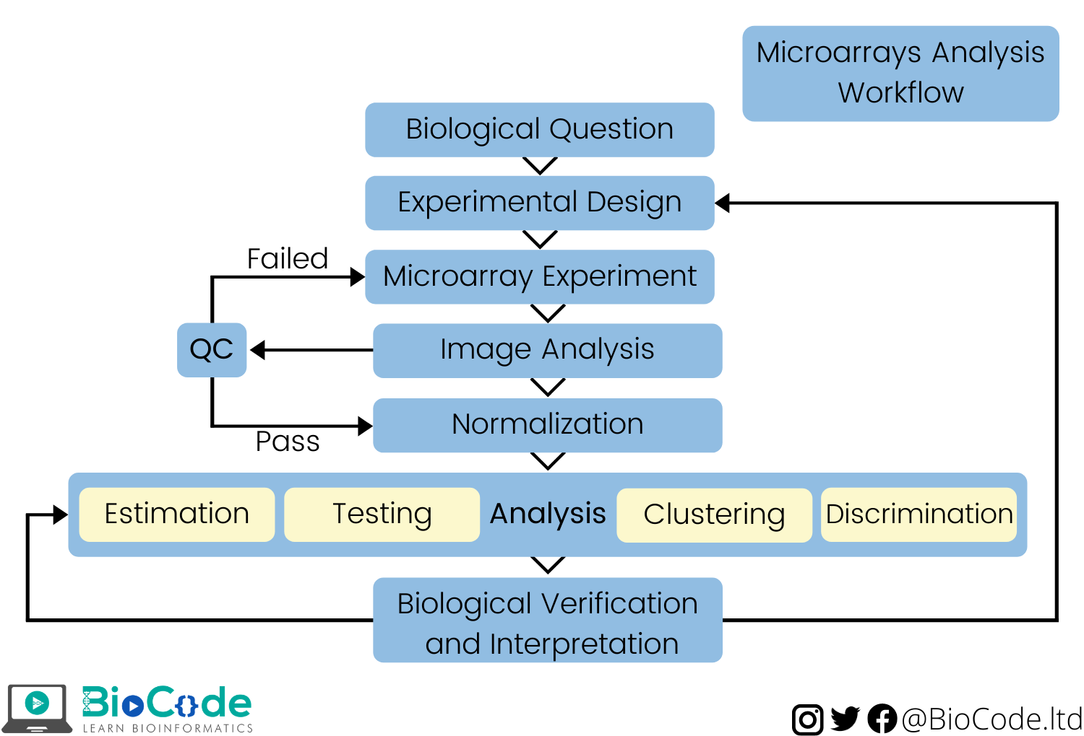
Basic aspects of microarray technology and data analysis.

Slide 5
ArrayExpress is one of the repositories recommended by major scientific journals to archive functional genomics data from microarray and sequencing platforms to support reproducible research.

Slide 6
Raw Data
Experiment
Intensity values that are being calculated from the microarray images
DNA assay, RNA assay, amplicon sequencing, metabolomic profiling, protein assay
Files
ArrayExpress
Database
Technology
Investigation description, Sample and data relationship
Array assay, high-throughput sequencing, mass spectrometry
Status
Original data
Experiment submitted, updated and released date.
experiments submitted directly to ArrayExpress, not imported from the NCBI Gene Expression Omnibus (GEO).

Slide 7
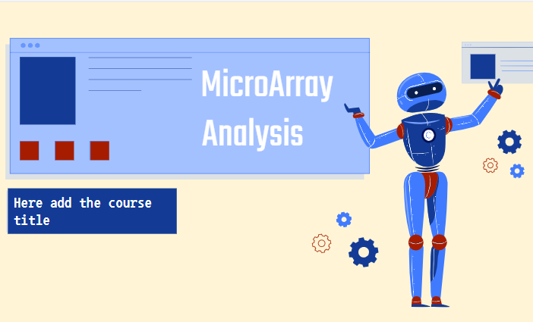

Conclusion
Microarray analysis allow researchers to investigate the expression state of a large number of genes, in many cases, an organism's entire genome in a single experiment.

Slide 8
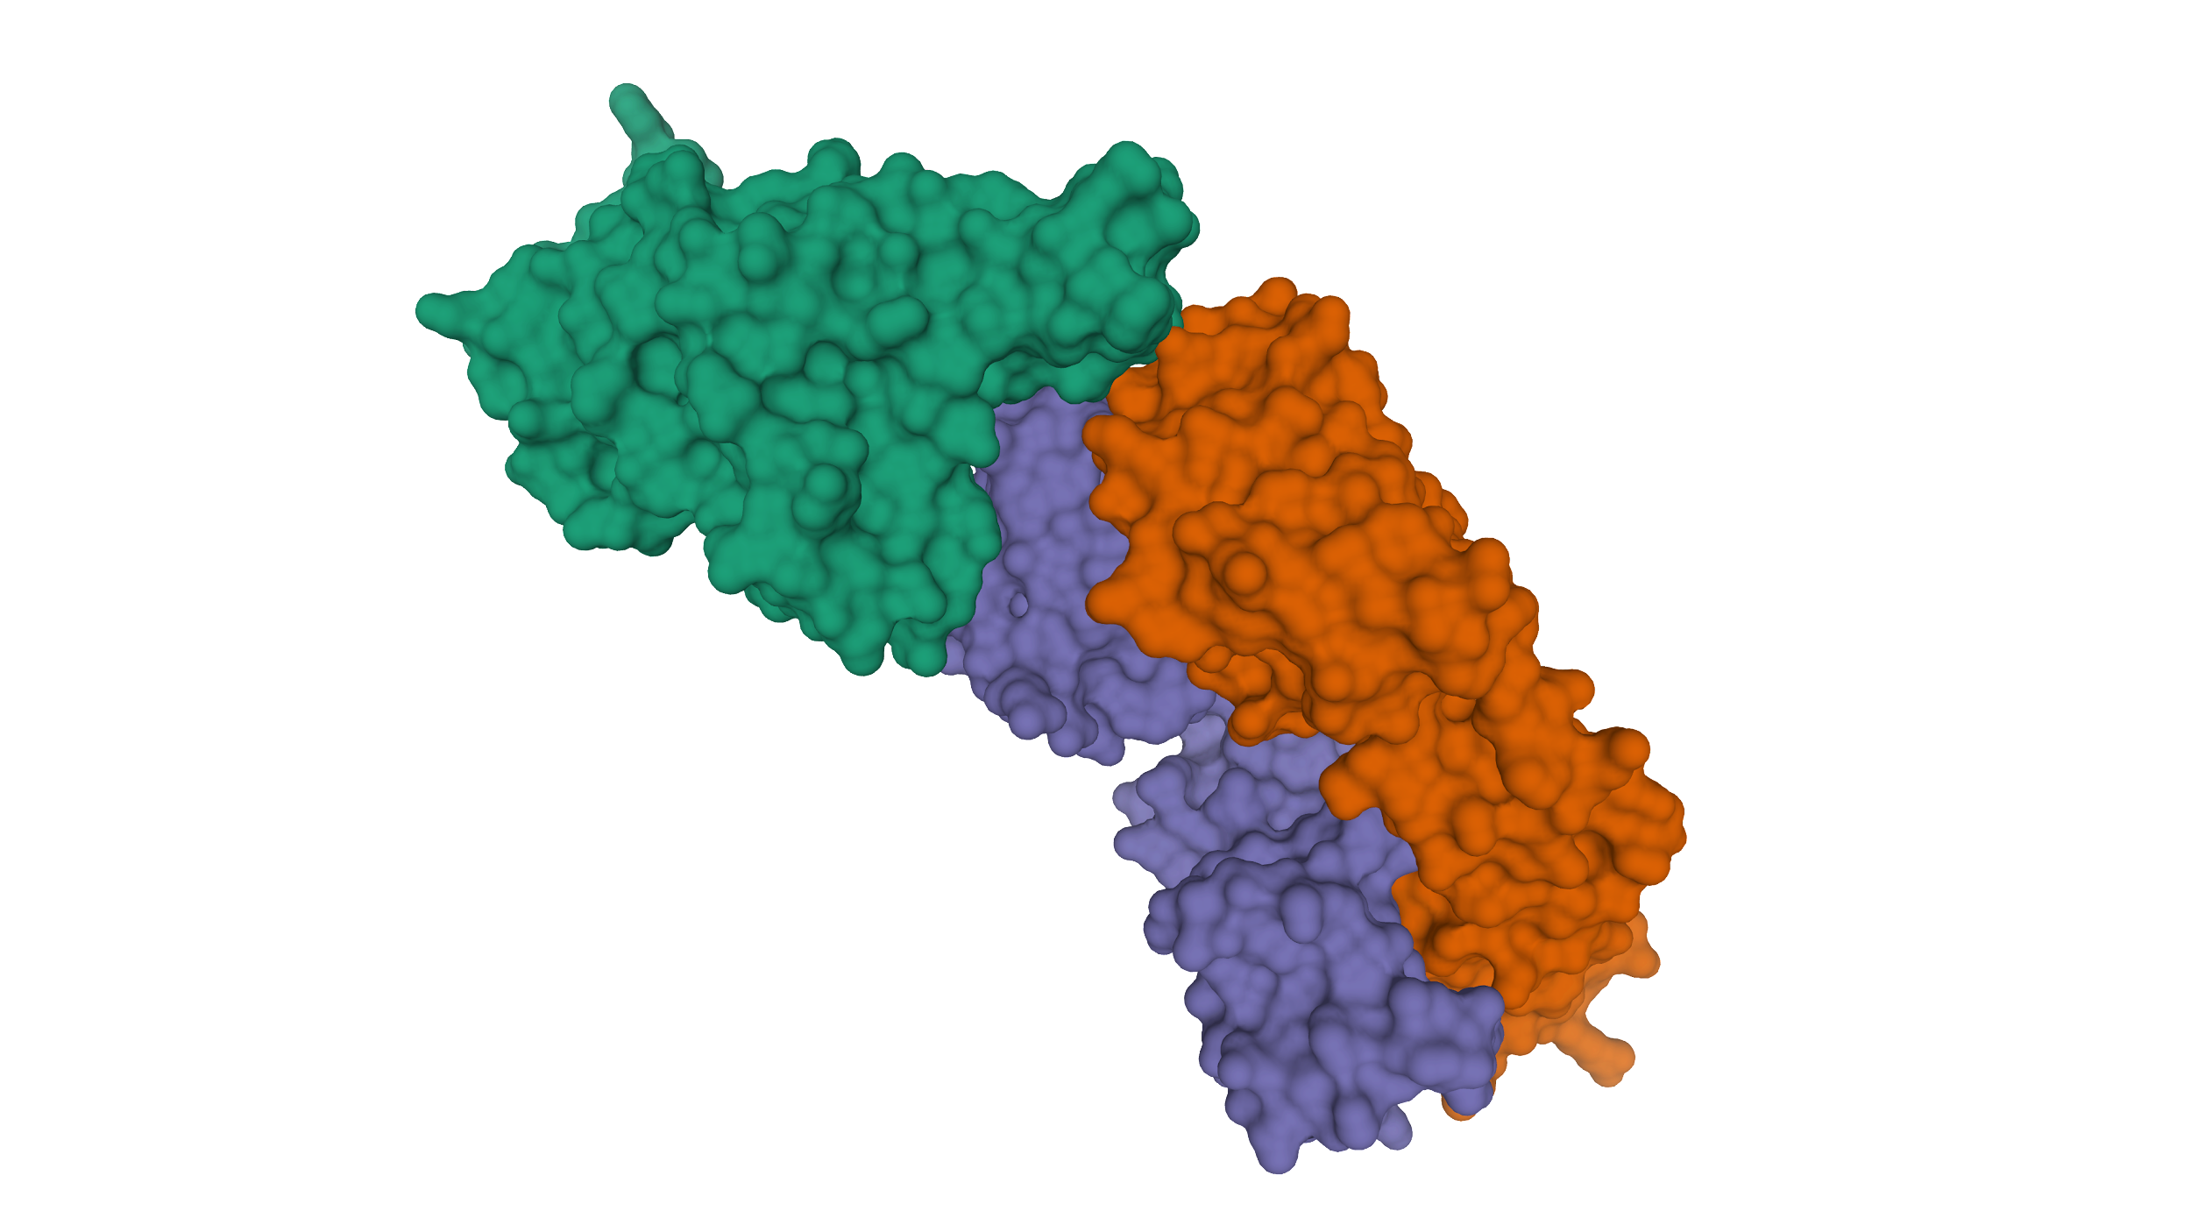

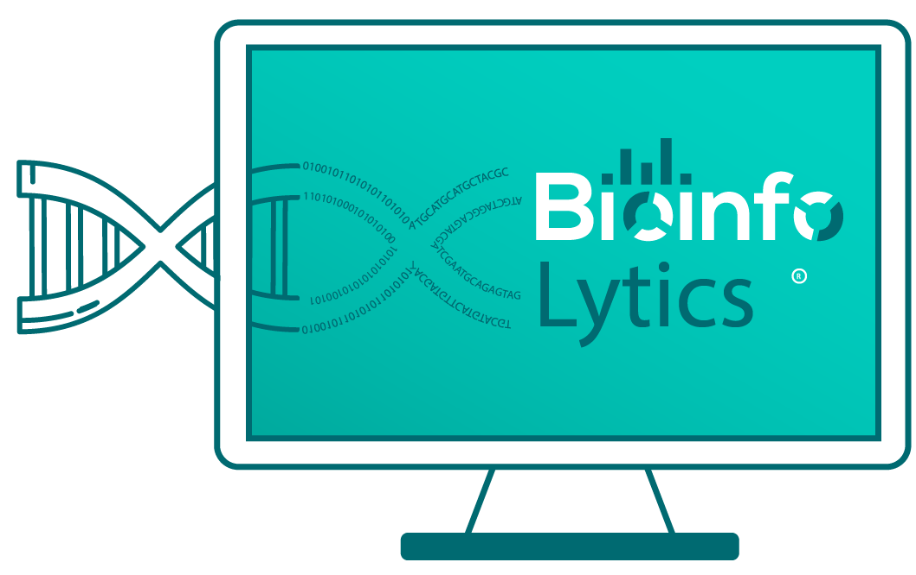
Learn Bioinformatics
Through Interactive Video Courses
Ever stuck upon a bioinformatics, computational biology, biological programming problem?
Do you want to learn Bioinformatics, Computational Biology, Biological Databases, Biological Programming?
Interactive Video Courses Available
Gray
Bioinformatics
Gold
Bioinformatics
Gem
Bioinformatics
Bioinformatics Premium Services
Enroll Now
Purchase Services
Bioinformatics & Computational Biology Courses
Biological Programming in Python & R Courses
Advanced Bioinformatics and Biological Programming Courses
9.99 USD/Month
16.99 USD/Month
18.99 USD/Month

