Slide 1

Homology Modeling Using MOE

Slide 2
Content
Introduction
Objectives
Input & Output
Methodology
Conclusion

Slide 3

Introduction
Homology modeling is the process of constructing an atomic-resolution model of the target protein from its amino acid sequences and an experimental 3D structure of a related homologous protein 'the template'. MOE is an efficient tool for homology modeling.

Slide 4
“
Multipurpose tool which integrates visualization, modeling and simulations, as well as methodology development for drug discovery”

Slide 5
Objectives
Analyzes
MOE is a platform for drug discovery which provides applications such as structure-based design, fragment based design and others.
Research Outcome
Available on
MOE is a standalone program and can be installed on windows, Linux & MacOS.
MOE integrates visualization, modeling and simulations for protein 3D structure.

Slide 6

Input & Output
Input
Output
MOE can read most common file formats (sdf, SMILES, pdb, mol2, FASTA) as well as the internal .moe file type.
MOE results in the structural conformation for input files. The generated conformations can be stored and analyzed later.

Slide 7
Other Tools
Structure Builders
MOE provides access to a variety of other tools including sorting and structure based searching.
Variety of structure builders supplied that can be used to build or edit systems of varying complexity
Plotting
Methodology
Conformation
Plot functionality provides a simple visual comparison of the properties.
Conformational analysis using either a systematic or a stochastic search.
Simulation
Modeling
MOE integrates simulation a for protein 3D structure.
MOE integrates modeling a for protein 3D structure.

Slide 8

Conclusion
MOE is an efficient and widely used tool to generate homology 3D models of proteins and also align structures of proteins.

Slide 9
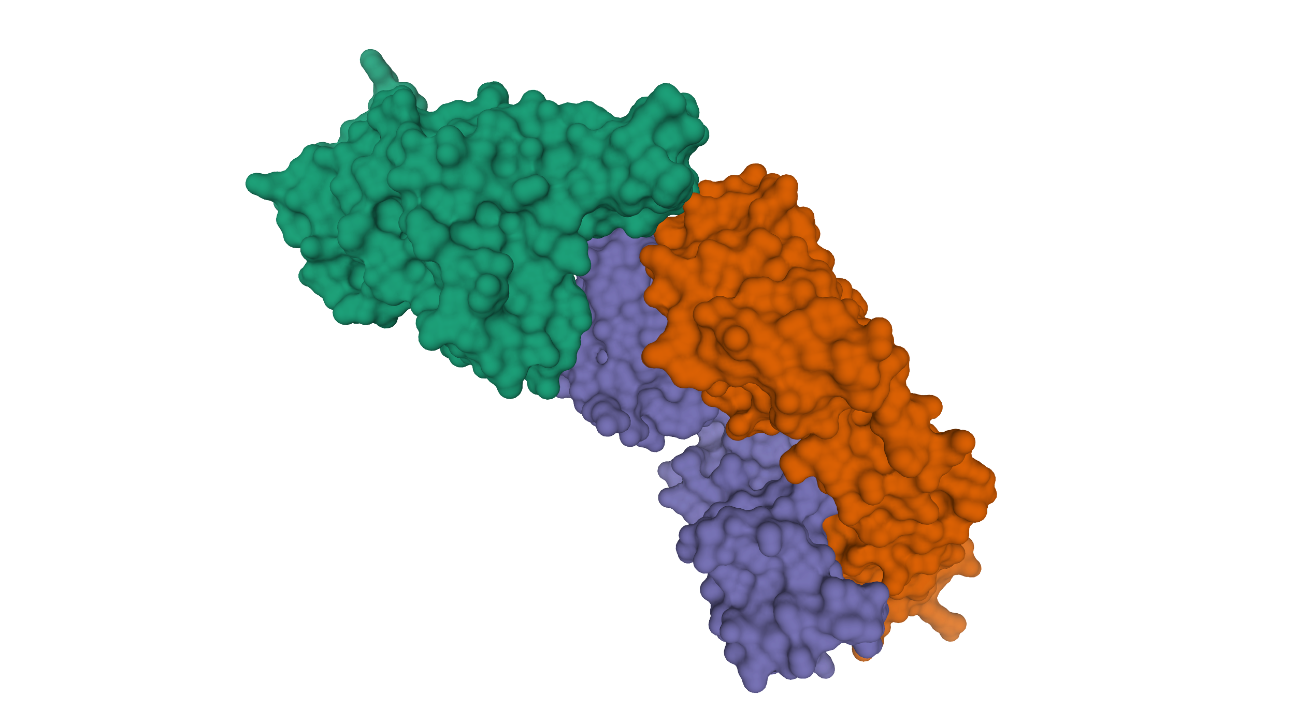

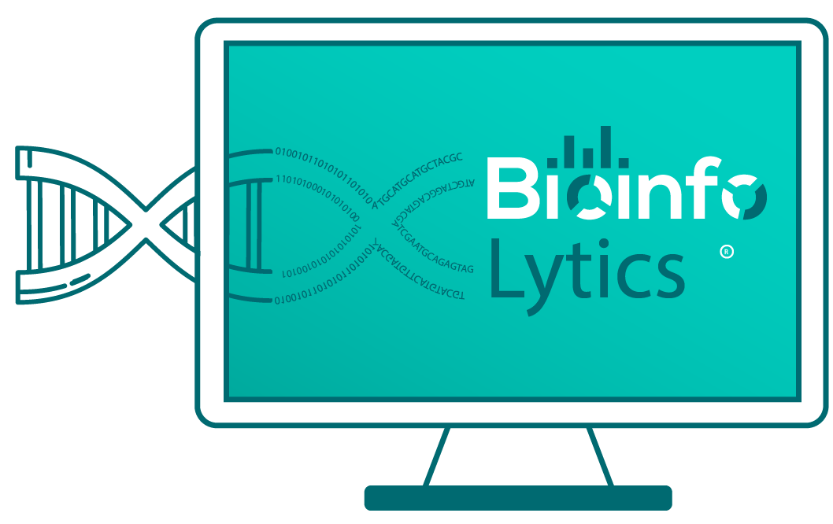
Learn Bioinformatics
Through Interactive Video Courses
Ever stuck upon a bioinformatics, computational biology, biological programming problem?
Do you want to learn Bioinformatics, Computational Biology, Biological Databases, Biological Programming?
Interactive Video Courses Available
Gray
Bioinformatics
Gold
Bioinformatics
Gem
Bioinformatics
Bioinformatics Premium Services
Enroll Now
Purchase Services
Bioinformatics & Computational Biology Courses
Biological Programming in Python & R Courses
Advanced Bioinformatics and Biological Programming Courses
9.99 USD/Month
16.99 USD/Month
18.99 USD/Month

