Slide 1

Introduction to National Center for Biotechnology
A comprehensive Website for Biologists

Slide 2
Content
Basic Description
Introduction
Objectives
Input & Output
Goals
Conclusion

Slide 3
“
NCBI was established as the government’s response and developed by National Library of Medicine (NLM) at the National Institute of Health (NIH).”

Slide 4


Introduction
The National Center for Biotechnology, is the primary database that consists of experimentally derived data such as nucleotide sequence and protein sequence. NCBI contains a series of sub-databases relevant to Biotechnology and Biomedicine.

Slide 5
Objectives
Storing & Retrieval
Databases
Tools
Provides automated systems for storing & retrieval of Data.
NCBI is the comprehensive source of biology-related databases.
Introduce various tools for viewing & analyzing data.

Slide 6
GenBank
NCBI along with EBI and CIB together form International Sequence Database Collaboration which act as the chief working unit and information center. NCBI has three collaborative databases:
DNA Database of Japan (DDBJ)
European Molecular Biology Laboratory Database (EMBL)

Slide 7
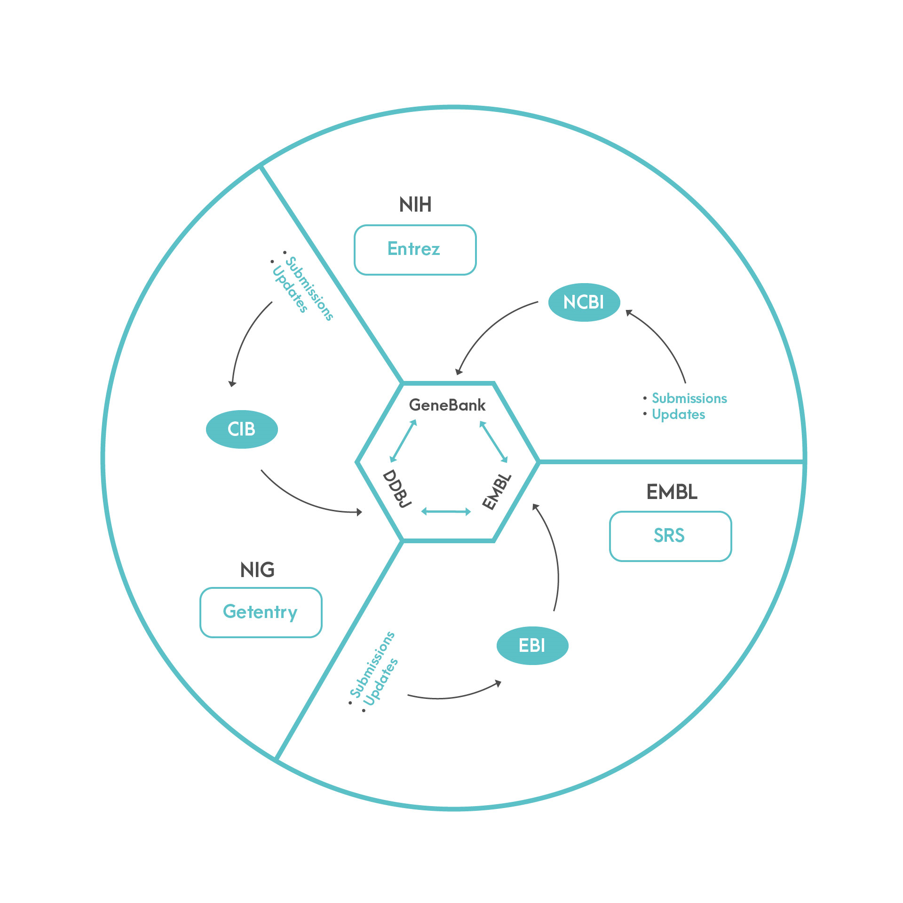
International Sequence Database Collaboration Working

Slide 8
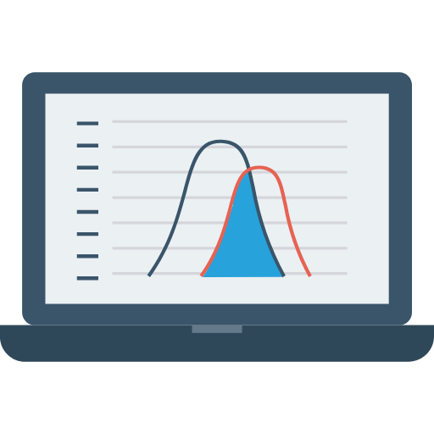
Input & Output
Input
Output
The database requires to search the query through the name, keyword or accession number in the relevant source database.
Different sort of databases contains different data. It provides the query results in the relevant source databases along with the sequence information in FASTA or GenBank formats.

Slide 9
Submit
Download
NCBI Goals
Research
Learn
Analyze
Develop
Deposit data into NCBI databases
Transfer NCBI data to your computer
Explore NCBI research and projects
Provides help documents and tutorials
Provides NCBI tools for data analysis task
Provides NCBI APIs and code libraries to develop applications

Slide 10

Conclusion
The National Center for Biotechnology Information advances science and health by providing access to biomedical and genomic information. It was established in need for better processing methods to deal with vast amount of data.

Slide 11

Enroll now! www.biocode.ltd

Slide 12
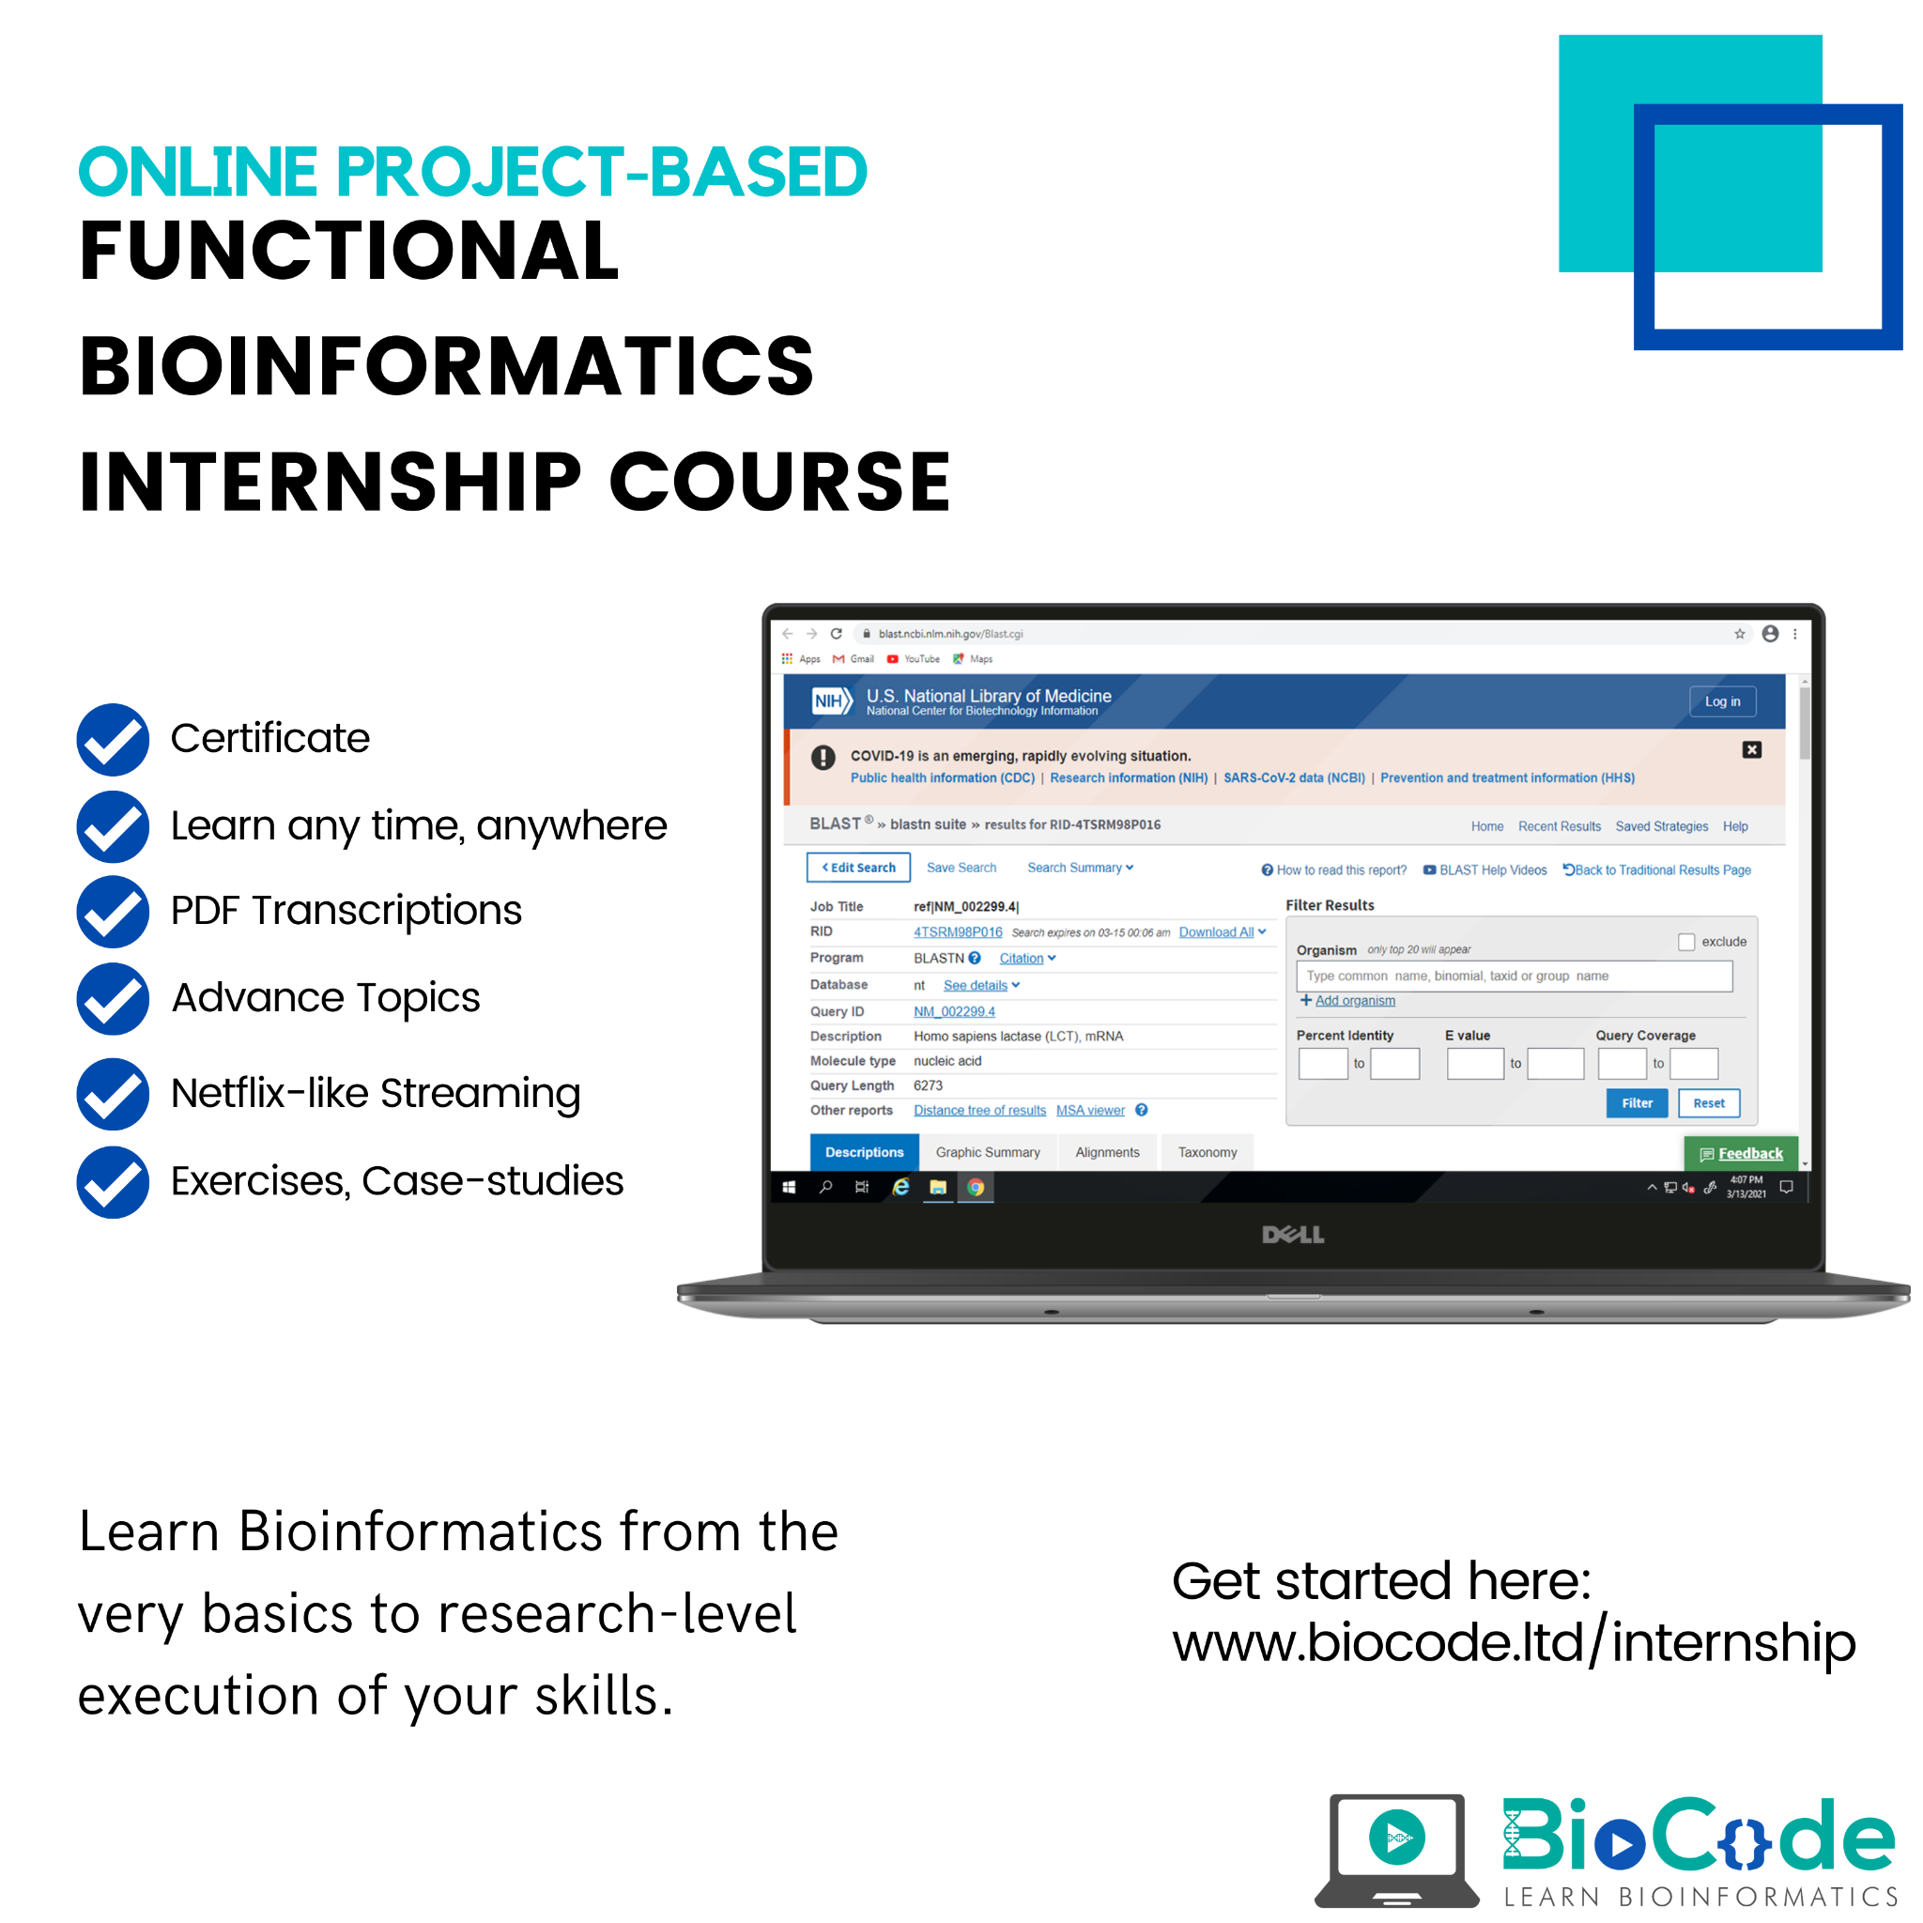
Enroll now! www.biocode.ltd/internship

